Slide 1
Unlocking cyber insights with AI: Using ML and LLMs for next-gen analysis
Xenia Mountrouidou, PhD
Principal Cyber Data Scientist | Expel
SANS AI Cyber Summit
March 31- April 1, 2025
Notes:
Hello everyone, today I will talk about some interesting research that we do at expel looking for the best models for cybersecurity applications.

Slide 2
Agenda
AI for cybersecurity
How can we help security practitioners with AI?
EDA with LLMs
How can we apply AI to explore cybersecurity data?
Classification with LLMs
Does AI help in predicting malicious behavior in cybersecurity data?
Notes:
Specifically, I will talk about what data we have in our availability from cybersecurity sources and applications, and how can we help analysts make sense of their data. Then I will get into Exploratory Data Analysis with LLMs. This may resonate a lot with junior/senior data scientists that use EDA in their day to day, however it may also be useful for analysts that deal with a lot of data as a black box and want to make sense of it. Finally, I am going to demonstrate some of our findings with classification experiments and LLMs, the good the bad and the ugly.
This talk is for junior/senior data scientists and for security practitioners that want to improve their data fu

Slide 3

Agenda
AI for cybersecurity
EDA with LLMs
Classification with LLMs
Notes:
Here I can make a joke: story of our life in CS renaming things and getting more crowds to join…

Slide 4
Predict or Generate?
AI in Cybersecurity
Data & Applications
Notes:
How can we help security practitioners with AI?

Slide 5
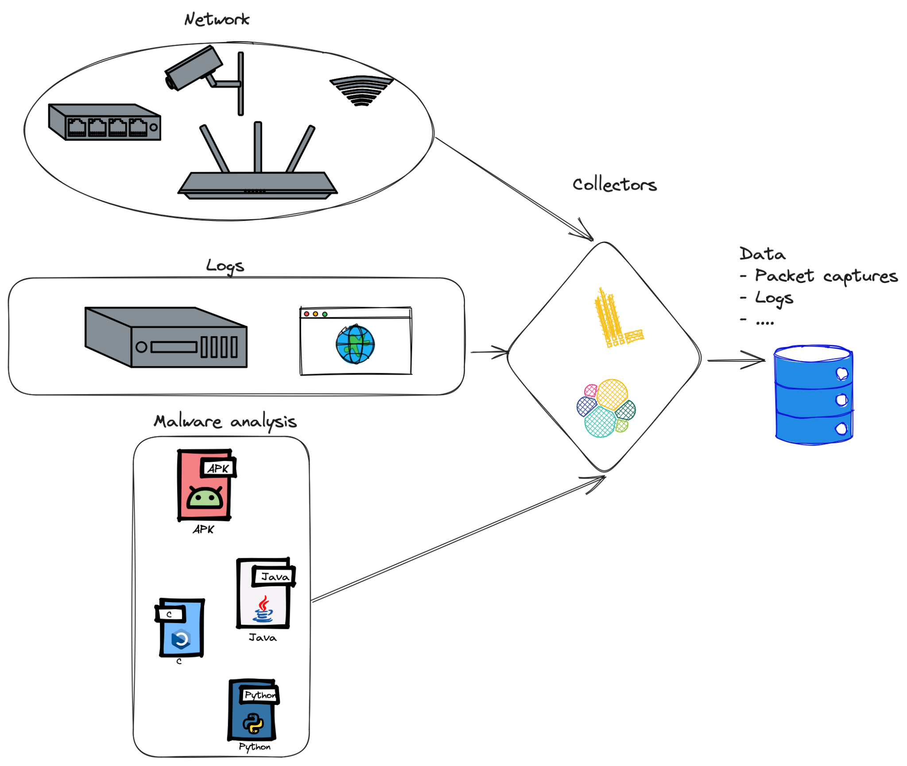


Data
Sources
Types
Notes:
Sources
Network
Malware
Systems
Fuzzing
Types
Packet captures
Netflow
Binaries
Static analysis
Dynamic analysis
Logs
Domains
URLs
Passwords
Payloads

Slide 6
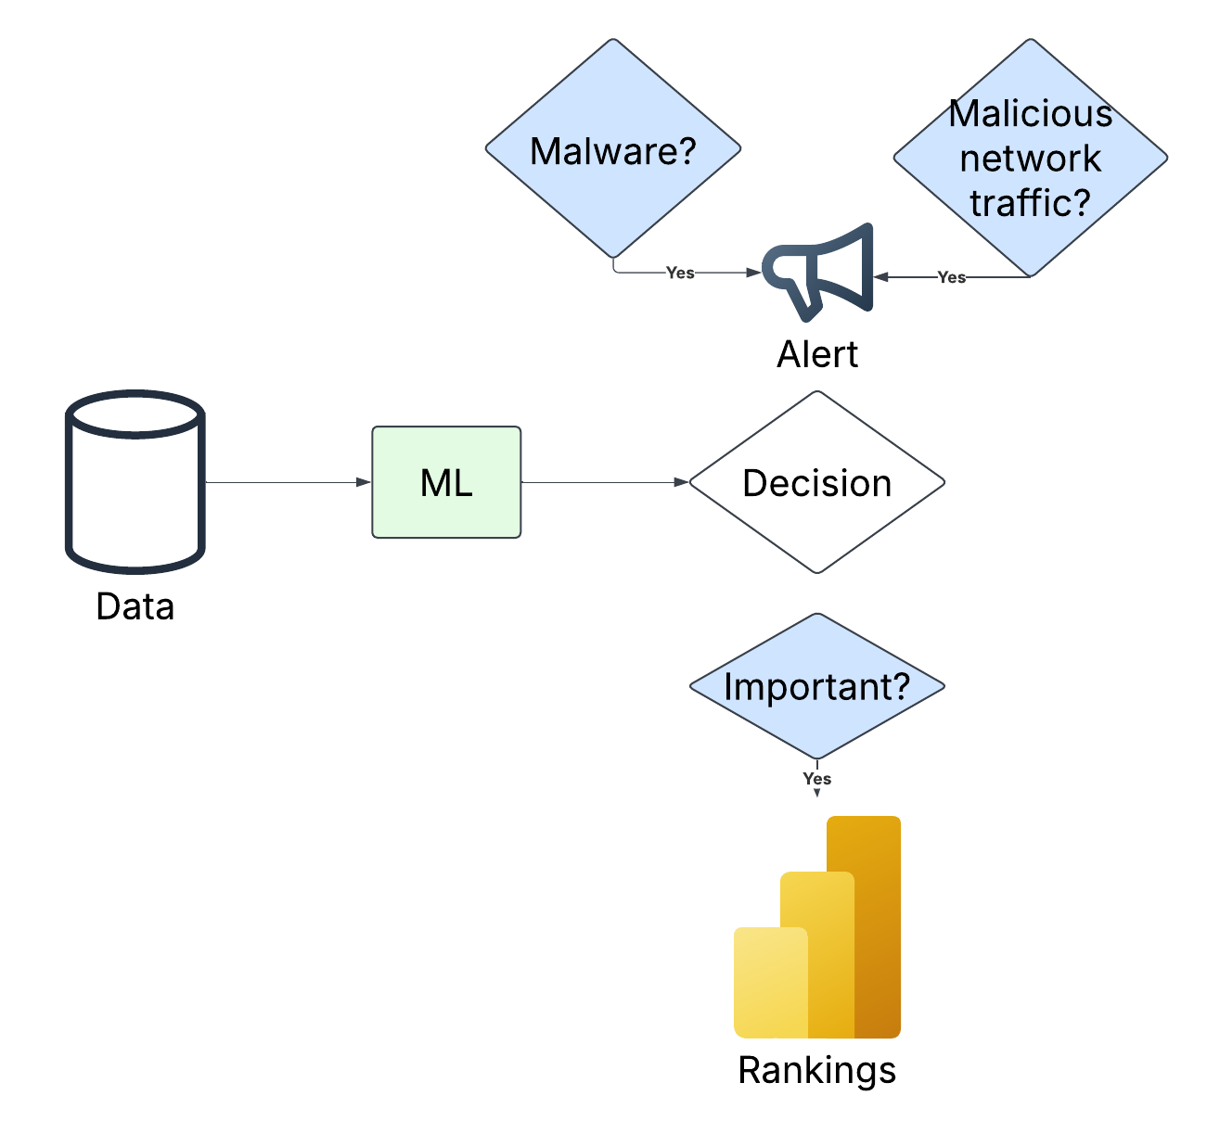





Applications
Recognize patterns
Predict the future
Make decisions
Automate
Test
Notes:
May change that figure depending on time
Recognize patterns
Anomaly detection
Intrusion Detection
Malware
Spam, Phishing
Predict the future
Hunting simulations
Threat intelligence: predict next move
Make decisions
Block or allow?
Prioritize
Automate
Generate reports
Create playbooks
Discover vulnerabilities
Test
Automated pen tests
Simulate attacks

Slide 7
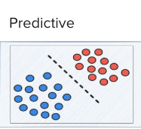
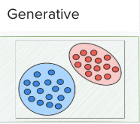
Predict or Generate?
Predictive models learn decision boundaries.
Traditional ML models, pre LLMs
Cannot generate new data
Specifically meant for classification, prediction
Predictive models do not possess generative properties
Generative models learn the input distribution
LLMs and Gen AI multi-modal models
Typically not used for classification, prediction
Can generate new data
Generative models possess discriminative properties

Slide 8
Exploring where no man has gone before
EDA with AI
Notes:
How can we apply AI to explore cybersecurity data?

Slide 9
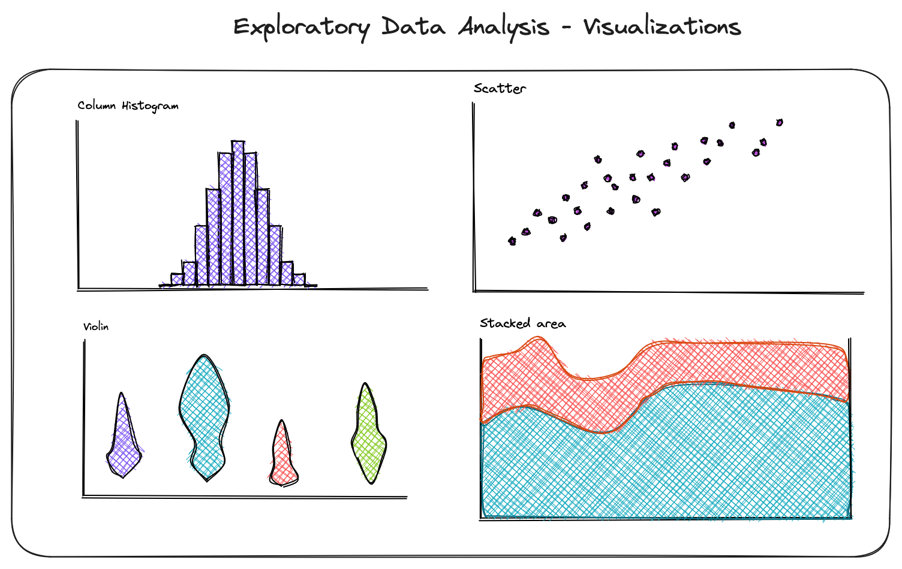
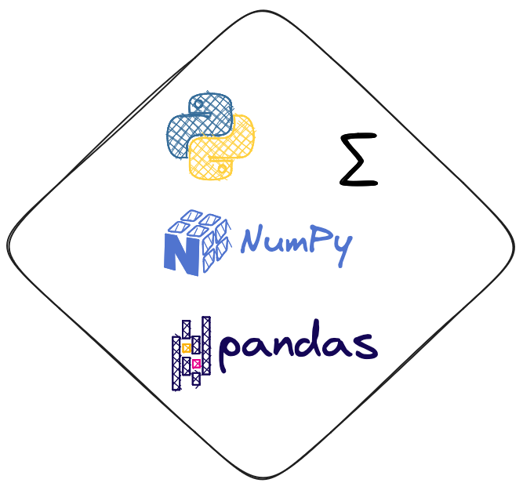
Exploratory Data Analysis (EDA)
Visualizations
Statistics

Slide 10

Why EDA?
Data is messy—it may be a complete black box.
Know your data better:
Feature engineering
Modeling
Questions about data:
Is it accessible?
Is it usable? EDA
Is it understandable? EDA
Is it sizeable? EDA
Is it reliable?
Notes:
Usable: missing values? Duplicates? Up to date? Representative? Complete?
Understandable: where do the attributes com from? Can data leakage happen?
Sizeable: do we have enough?
Reliable: can we trust the labels?

Slide 11

Why EDA for cybersecurity data?
Cybersecurity data is messy
Unstructured
Unknown behavior in a system
Robustness is paramount
Predictive modeling
Decision making
Raw cybersecurity data
Not normalized
Unstructured
Notes:
Usable: missing values? Duplicates? Up to date? Representative? Complete?
Understandable: where do the attributes com from? Can data leakage happen?
Sizeable: do we have enough?
Reliable: can we trust the labels?

Slide 12
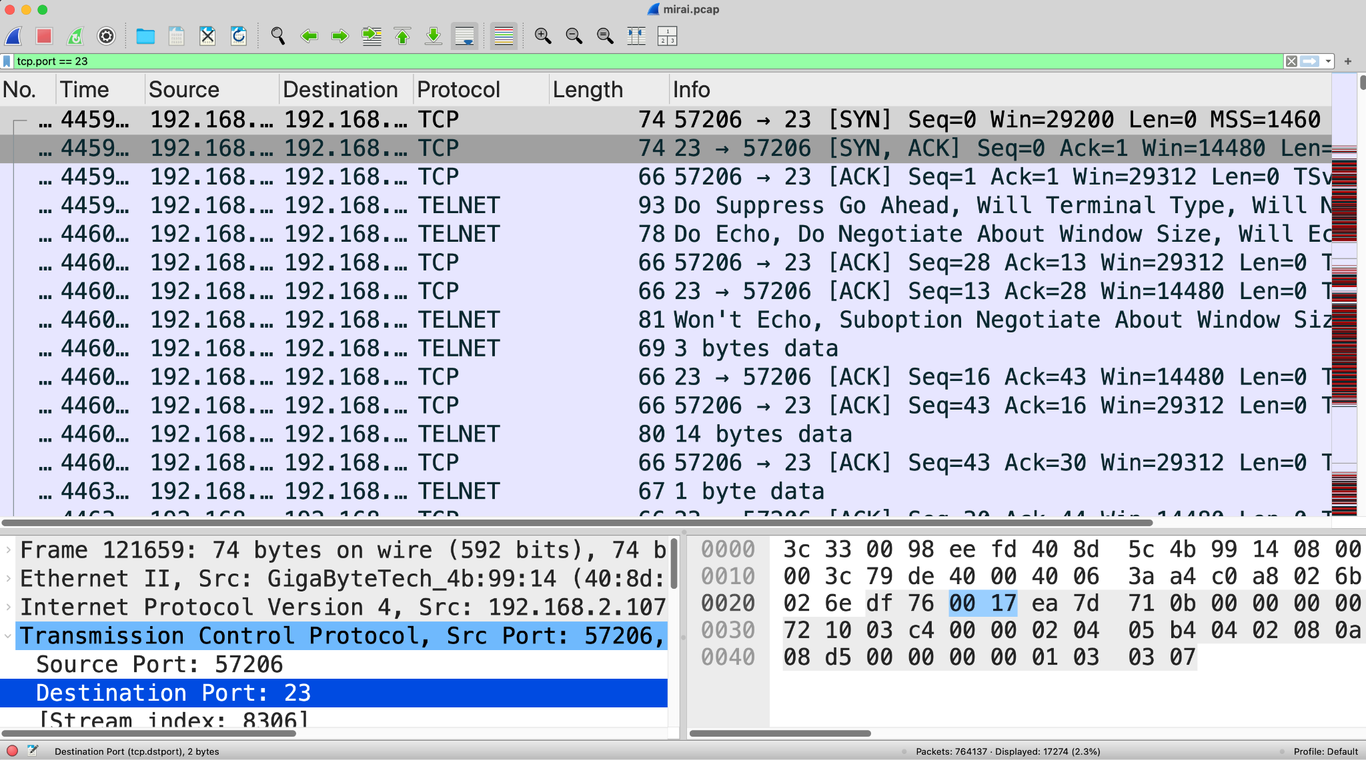
Dataset
Packet captures
Mirai Botnet
Benign network activity
Notes:
Benign behavior: normal time series profile (not huge bursts), ports that are safe services, payload that is usually encrypted (unencrypted may show malicious service)
Malicious behavior: malicious ips and domains, bursts of traffic, unusual packet sizes, unsecure services

Slide 13



Why these specific LLMs for EDA?
Model | Large? | Encoder? | Decoder? | Can reason?
Gemini
Palm
Mistral
Gemma
Llama
Phi
Notes:
More specific information about models:
Gemini-2.0-flash-001
Chat-bison (Palm based)
Llama3

Slide 14
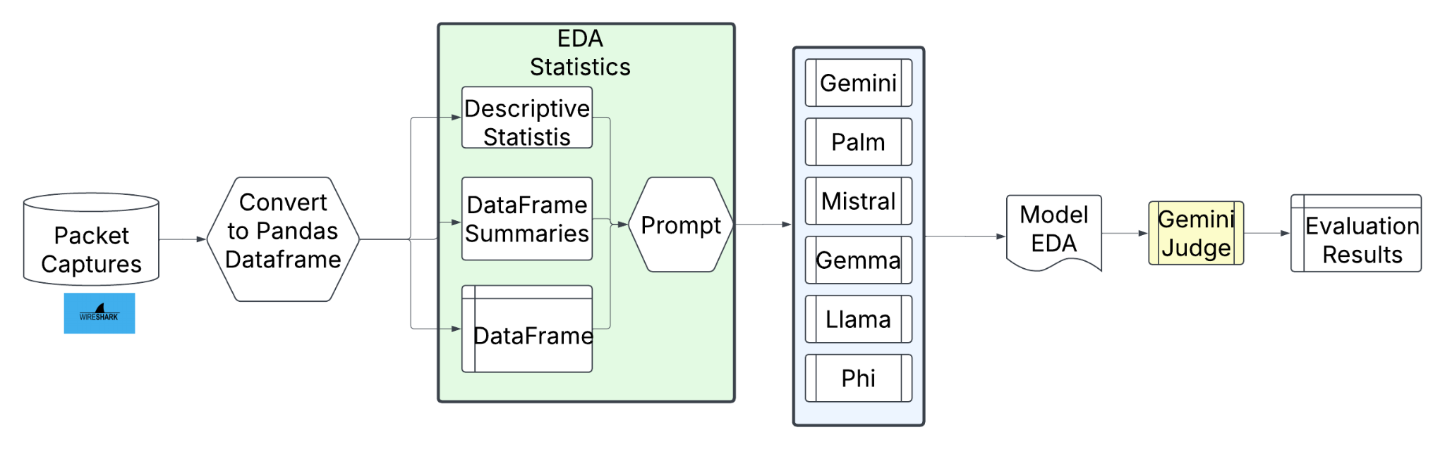
EDA with LLMs

Slide 15
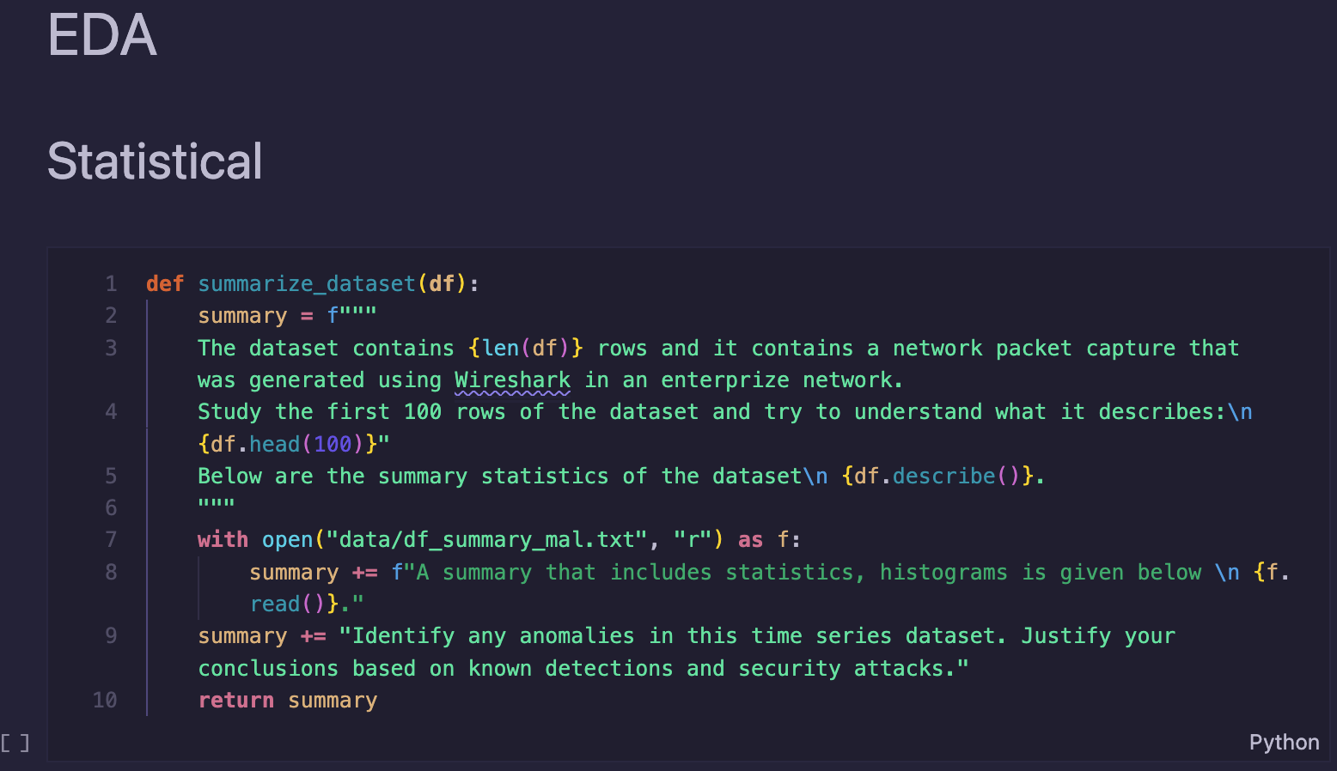
EDA with LLMs: statistics

Slide 16
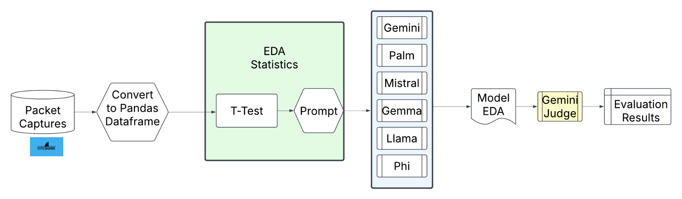
EDA with LLMs

Slide 17
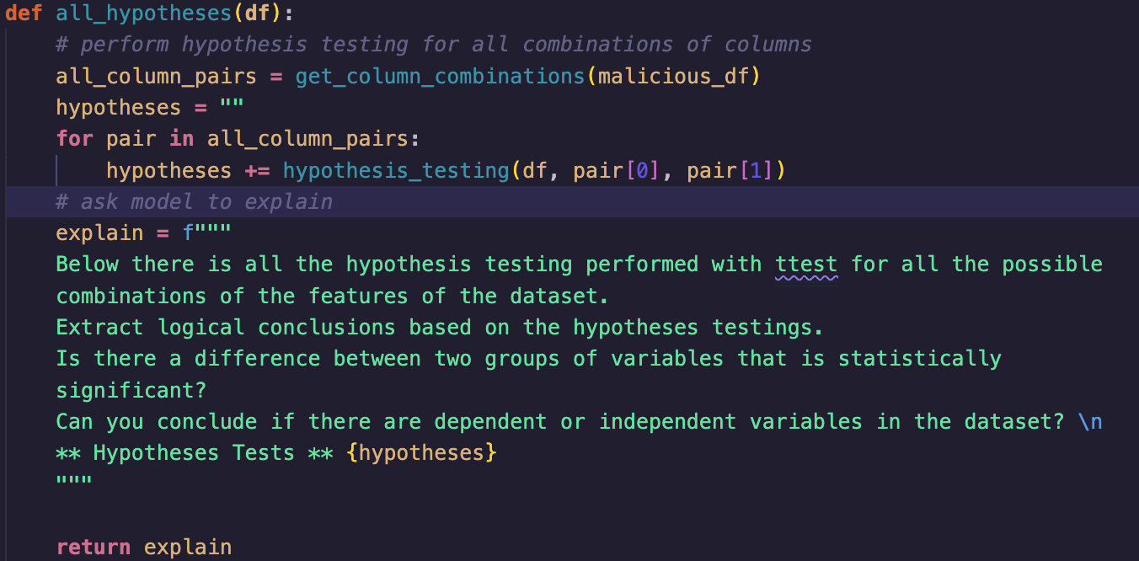
EDA with LLMs

Slide 18
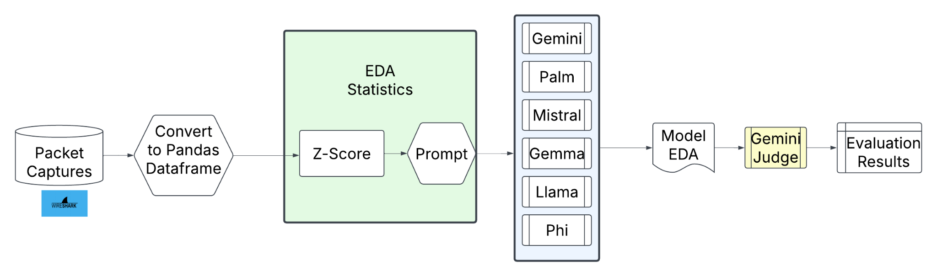
EDA with LLMs

Slide 19
Results

Slide 20
Qualitative Evaluation for Summary Statistics
Model | Correctness justification
Gemini | The actual output provides a detailed analysis that aligns well with the expected output. It identifies anomalies in port usage and DNS queries resembling IoT devices, mentions unusual UDP traffic, and discusses potential exfiltration issues with packet lengths. It highlights issues with interarrival times similar to a potential Denial of Service attack. The main difference is the additional emphasis on detailed packet analysis and payload inspection for further investigation in the actual output, without direct contradiction in opinions.
Palm | The actual output identifies anomalies like high interarrival time and packet length, but misses analysis on ports suggesting scanning, DNS payload patterns, and UDP activity noted in the expected output.
Mistral | Actual output identifies some anomalies consistent with expected output, like packet length and protocol use, but misses the expected attention to IoT and telnet-related activities and high frequency of specific ports indicative of scanning.

Slide 21
Qualitative Evaluation for Summary Statistics
Model | Correctness justification
Gemma | Actual output identifies protocol anomalies and DNS spoofing, aligning partially with expected output on DNS queries and UDP activity, but misses scanning conclusions and specific destination port observations linked to telnet and IoT concerns.
Llama3 | The actual output contains factual inaccuracies, such as misinterpretations of numerical values, and makes assumptions unsupported by provided data, like TCP being less common; while expected output correctly identifies port scanning and DNS queries patterns.
Phi | The actual output identifies an anomaly related to TCP SYN packets which is unmentioned in the expected output. Key points about source/destination ports, payloads, packet lengths, UDP protocol activity, and interarrival times were not covered, which indicate more varied potential anomalies.

Slide 22
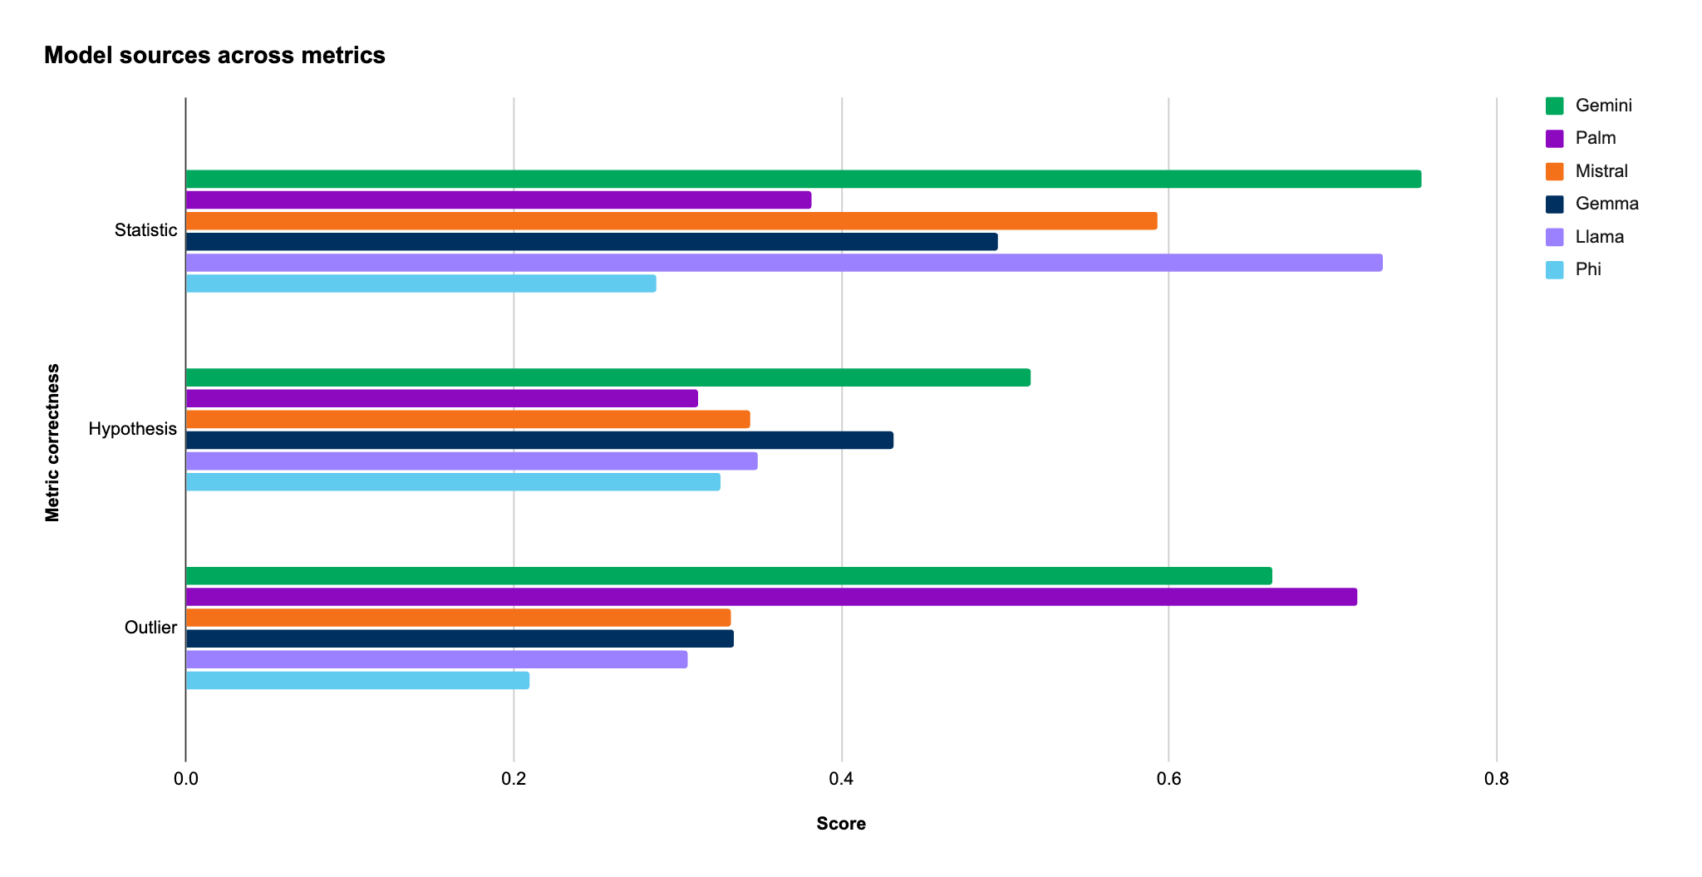
EDA with LLMs: Quantitative Evaluation

Slide 23
Can AI predict malicious behavior?
Classification with AI

Slide 24
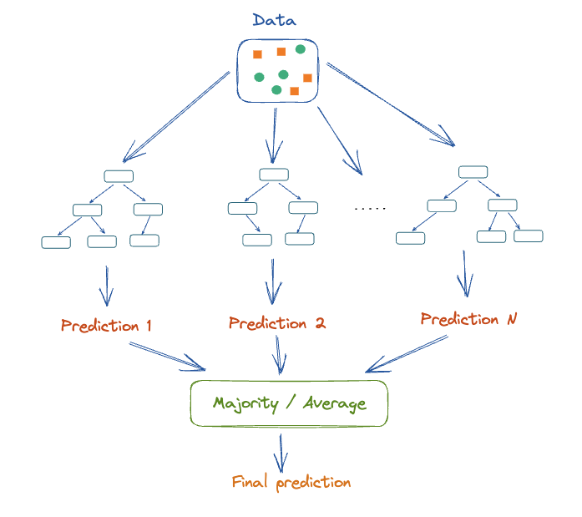
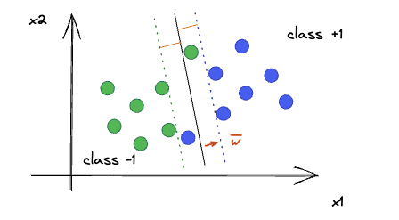
What is classification?

Slide 25




Why classify?
Classify malicious/abnormal behavior (network or system)
Find phishing emails
Find spam emails
Prioritize vulnerabilities
Correlate events
Notes:
Why LLMs for classification?
Text data
Not normalized data-normalization is expensive
Some structured data that does not have standardization

Slide 26
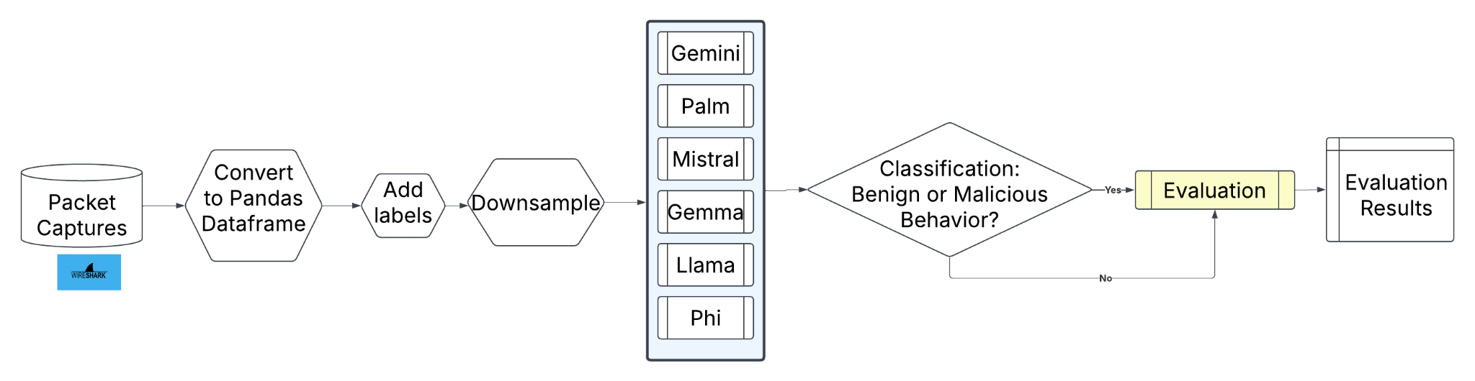
Classification with LLMs: scikit-llm

Slide 27
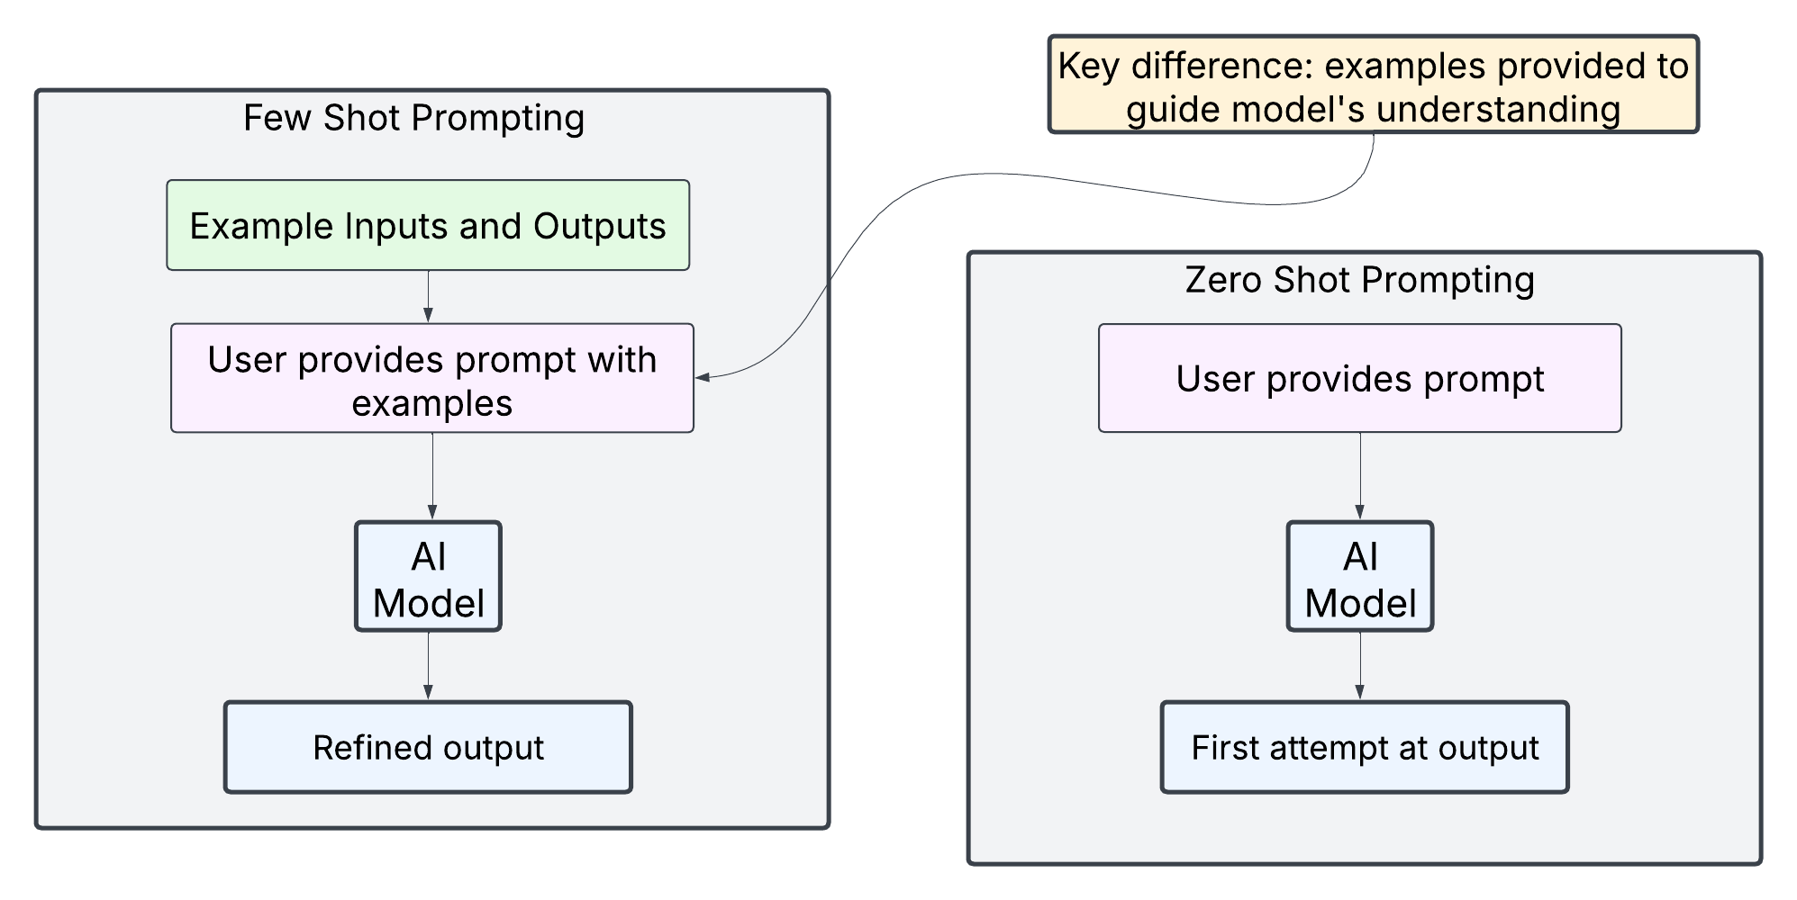
Classification with LLMs: prompting

Slide 28
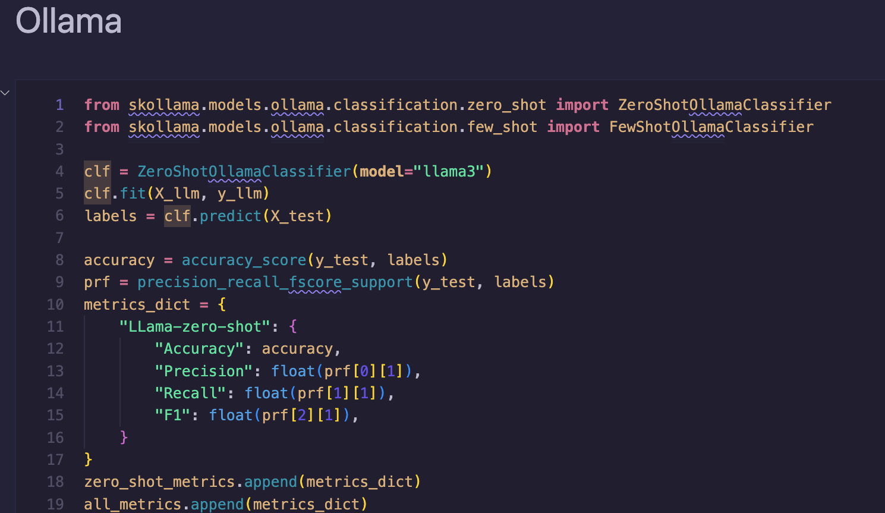
Classification with LLMs

Slide 29
Results

Slide 30
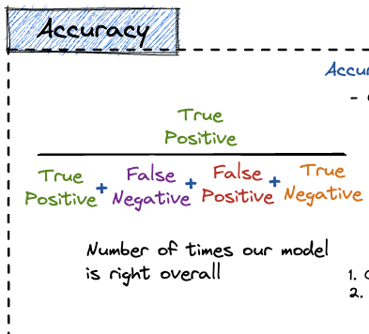
Classification evaluation

Slide 31
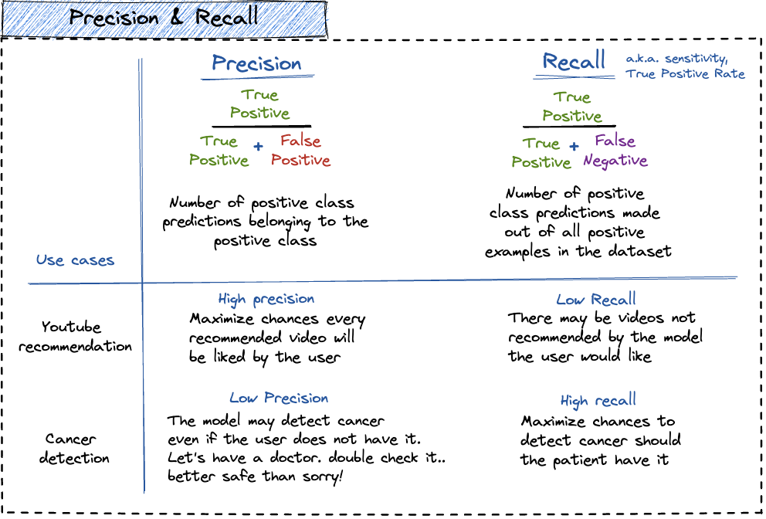
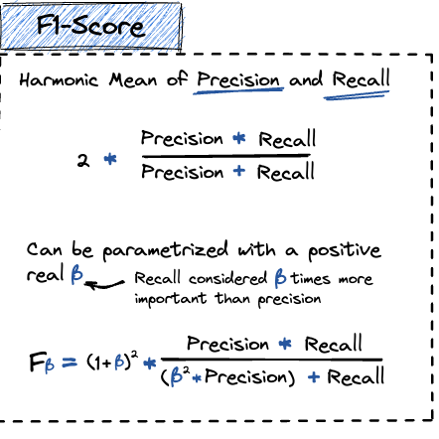
Classification evaluation

Slide 32
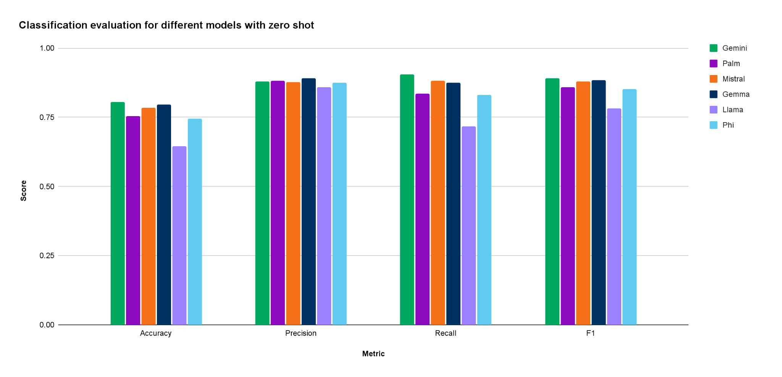
Classification evaluation: zero shot
Notes:
Womp womp pretty bad results but still consider zero shot does not give any examples

Slide 33
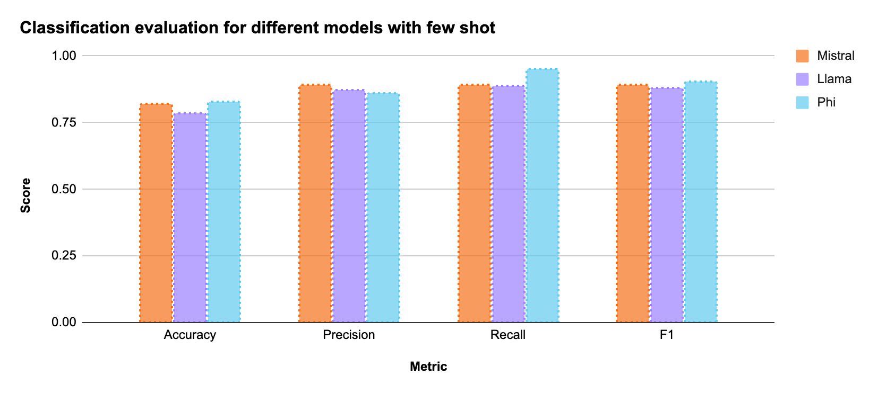
Classification evaluation: few shot

Slide 34
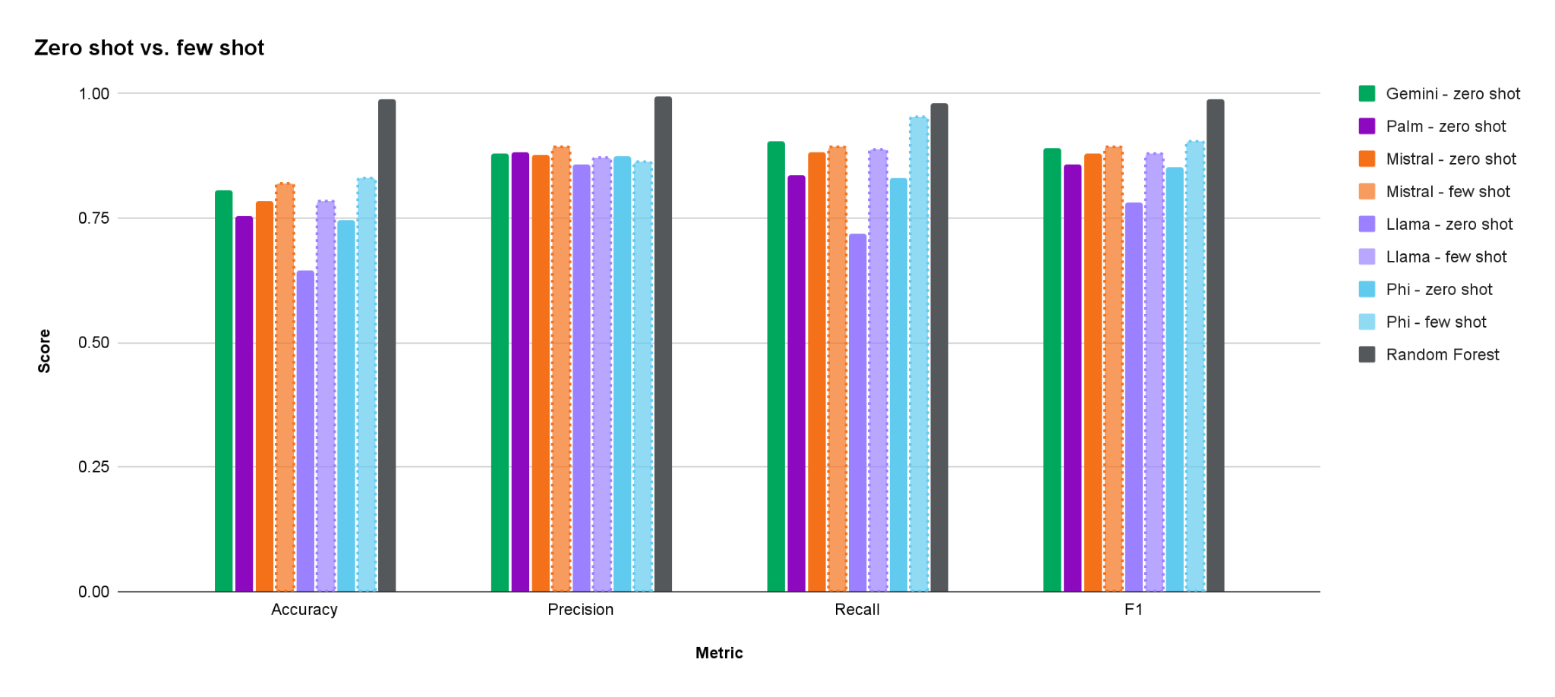
Classification evaluation: comparison

Slide 35
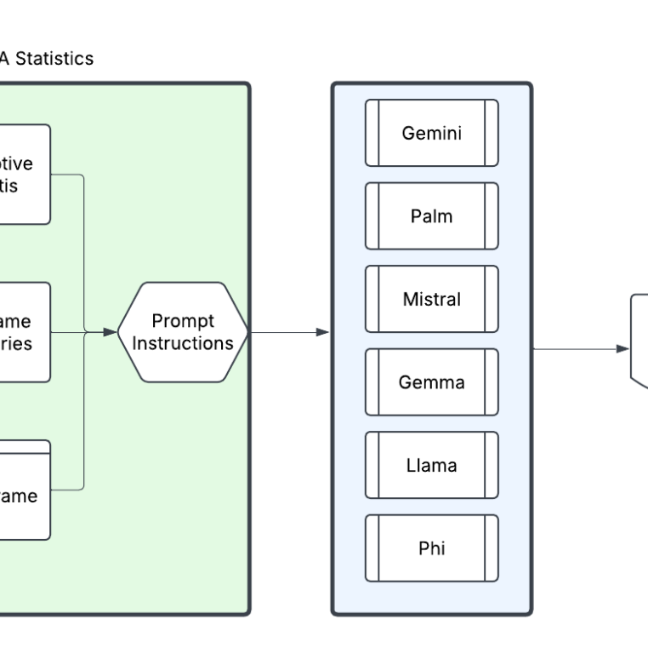
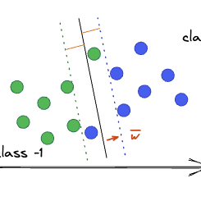
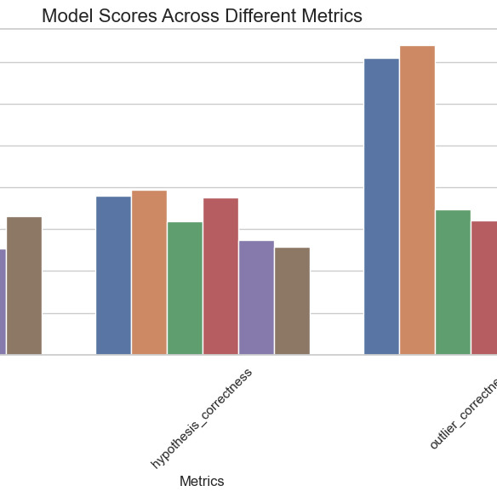
Key takeaways
EDA with LLMs
Qualitative insights & visualization prototyping
Classifications with LLMs
High potential for unlabeled datasets
LLMs as Judge
Promising, novel evaluation direction

Slide 36

NEXT STEPS
Try it at home
Fine tune models for better classification Experiment with: text benchmarks, CTFs
Use cybersecurity specialized embeddings
Agentic workflows for security applications
Create original metrics for LLM as Judge evaluation
RESOURCES
Use the code and experiment with different models: https://github.com/mundruid/cyberdata-mlai
REFERENCES
Slides 21, 27, and 28: https://illustrated-machine-learning.github.io/#/machine-learning/

Slide 37
Thank you
You can find the slides on my personal website: https://mundruid.github.io/
Xenia Mountrouidou
Principal Cyber Data Scientist
xenia.mountrouidou@expel.com

